Slide 1

The data class
Fork and clone repository
https://git.aspp.school/ASPP/2024-heraklion-data.git
Pietro Berkes & Verjinia Metodieva

Slide 2
Things one thinks about when thinking about data
Processing
Storage
Reproducibility and collaboration
Efficient processing (no for-loops!)
Organizing data so that analyses are easy
Size
Access ease
Access time
Versioning
Lineage tracing (which script / other data was used to generate this?)
Ease of sharing

Slide 3
Things one thinks about when thinking about data
Processing
Storage
Reproducibility and collaboration
Efficient processing (no for-loops!)
Organizing data so that analyses are easy
Size
Access ease
Access time
Versioning
Lineage tracing (which script / other data was used to generate this?)
Ease of sharing

Slide 4

Hands-on What data structure would you use to represent…

Slide 5
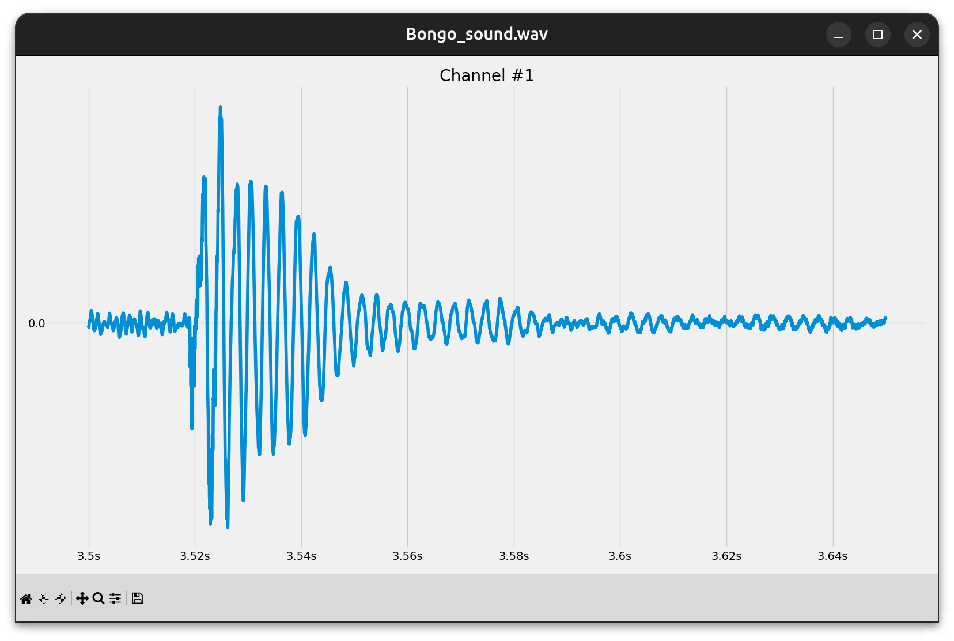
Hands-on What data structure would you use to represent…
A sound wave?

Slide 6
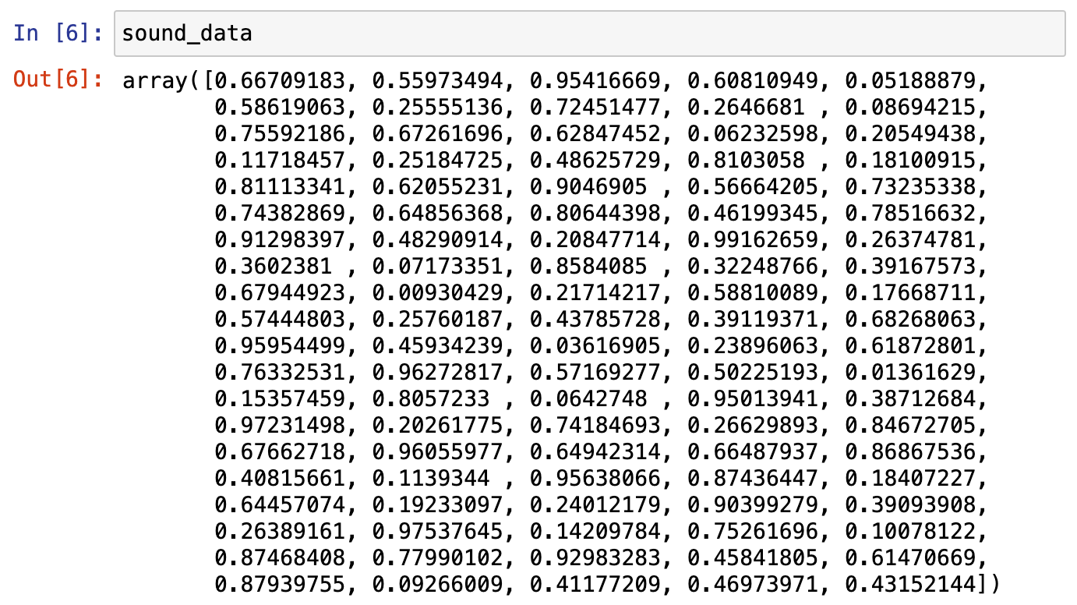
Hands-on What data structure would you use to represent…
A sound wave?
NumPy array

Slide 7
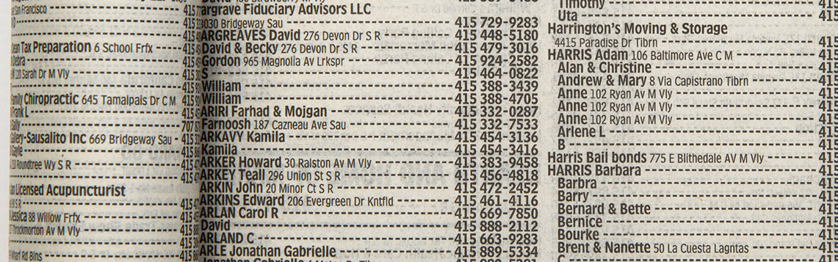
Hands-on What data structure would you use to represent…
Phone book entries?

Slide 8
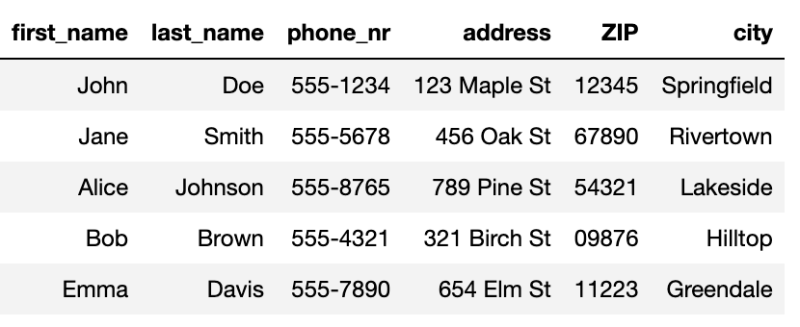
Hands-on What data structure would you use to represent…
Phone book entries?
Pandas DataFrame

Slide 9





Hands-on What data structure would you use to represent…
Friendship relations?

Slide 10
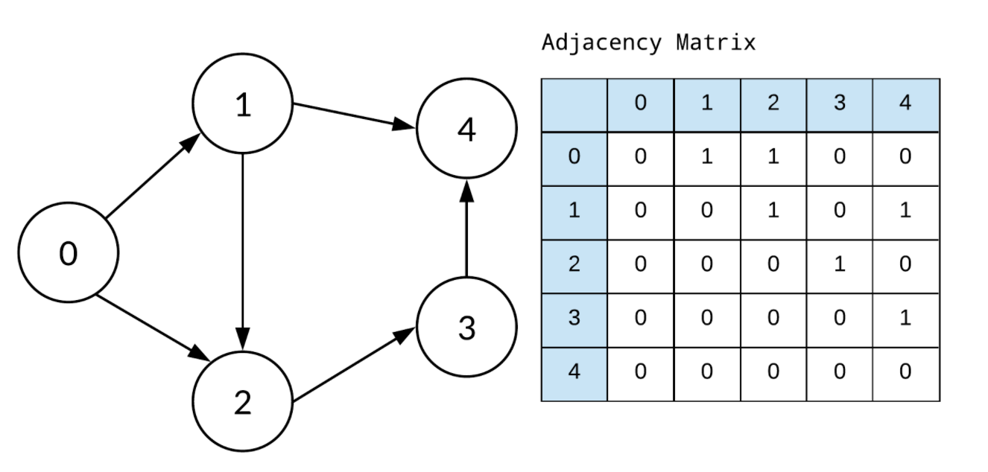
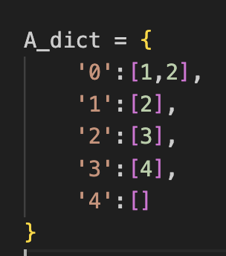
Hands-on What data structure would you use to represent…
Implemented as
Friendship relations?
Graph
Adjacency matrix (array)
Dictionary

Slide 11
You develop your code on a small data set, how is it going to scale to the complete data set?
Development data
Real data
N data points,
Processing time T
10x N data points
Processing time -> ?
We’re interested in orders of magnitude
Notes:
Data and code are related.
Nice transition from the last question. In extreme case, when the relations in the graph are dynamic/ changing a lot →using a dictionary is not a good solution. Instead, when small dataset and we are mainly interested in visualizing the relations, it might be.
The NumPy array solutions, scales much better, in case there are hundreds of dynamically changing relations to inspect.

Slide 12
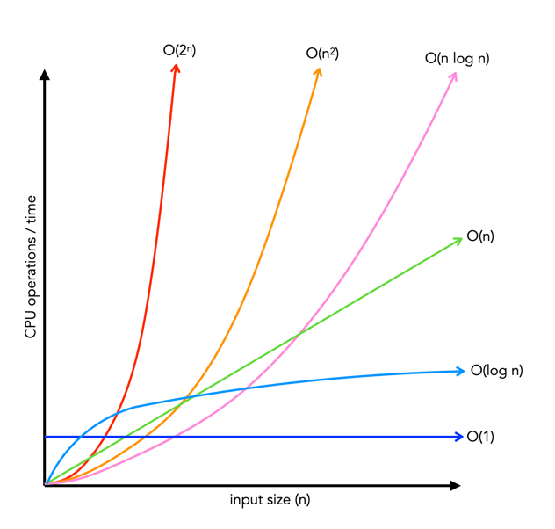
How performance scales: big-O
Big-O class | What we call it | Time increase, when data increases 10x
O(1) | constant | 1x time
O(n) | linear | 10x time
O(n²) | quadratic | 100x time
O(n * log n) | linearithmic | ~10-20x time
O(log n) | logarithmic | ~1-2x time
O(2^{n})
O(n²)
O(n log n)
O(n)
Time
O(log n)
O(1)
Input size, n

Slide 13
Hands-on: Operations on lists
Big-O class | What we call it | Time increase, when data increases 10x
O(1) | constant | 1x time
O(n) | linear | 10x time
O(n²) | quadratic | 100x time
O(n * log n) | linearithmic | ~10-20x time
O(log n) | logarithmic | ~1-2x time
O(2^{n})
O(n²)
O(n log n)
O(n)
Time
Big-O class | Operation on lists that scales this way
O(1)
O(n)
O(n²)
O(n * log n)
O(log n)
O(log n)
O(1)
Input size, n

Slide 14
Hands-on: Operations on lists
Big-O class | What we call it | Time increase, when data increases 10x
O(1) | constant | 1x time
O(n) | linear | 10x time
O(n²) | quadratic | 100x time
O(n * log n) | linearithmic | ~10-20x time
O(log n) | logarithmic | ~1-2x time
O(2^{n})
O(n²)
O(n log n)
O(n)
Time
Big-O class | Operation on lists that scales this way
O(1) | Getting an element by its index
O(n) | Summing elements in list
O(n²) | Computing distance between all pairs of elements in the list
O(n * log n) | Sorting the list
O(log n) | Searching an element in a sorted list
O(log n)
O(1)
Input size, n

Slide 15

Example: Find common words
Given two lists of words, extract all the words that are in common
Expected result: ['apple', 'orange', 'banana']

Slide 16

Implementation with two for-loops
What is the big-O complexity of this implementation?

Slide 17
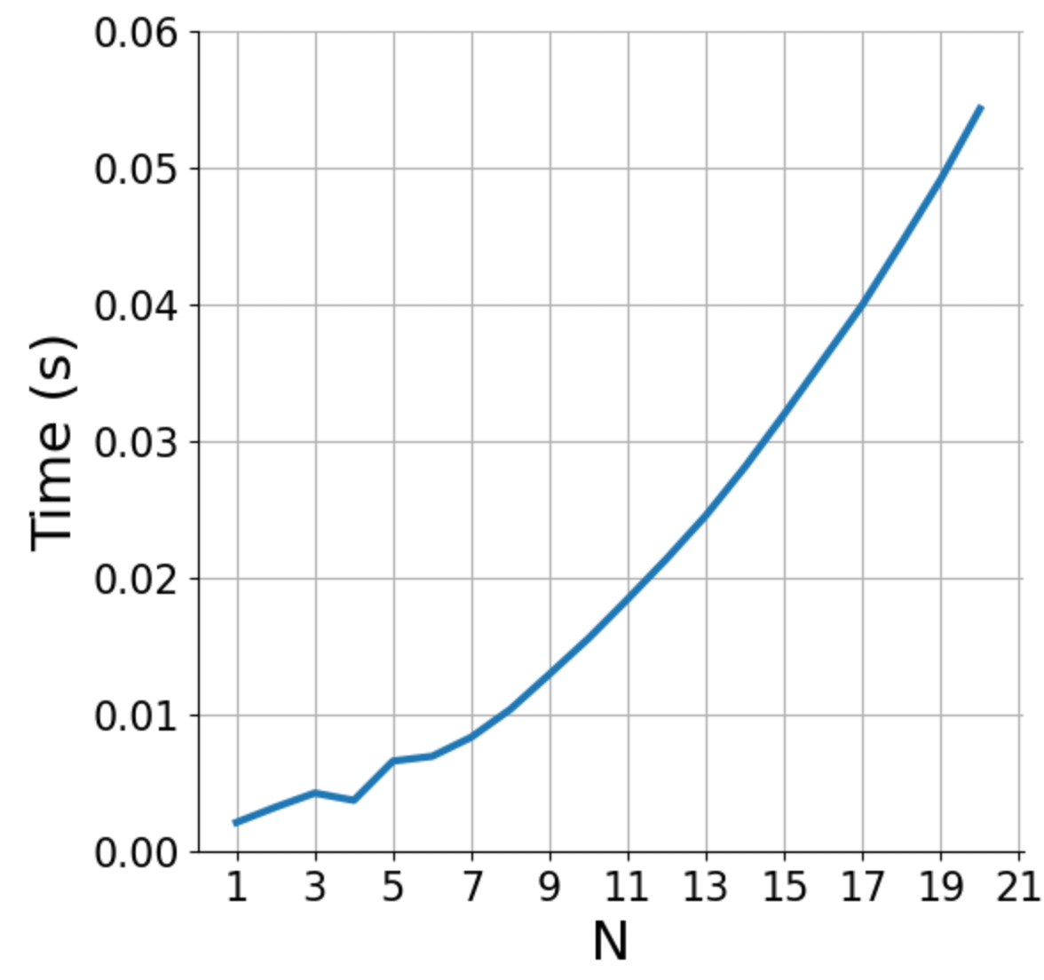
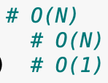
Implementation with two for-loops
What is the big-O complexity of this implementation?
N * N ~ O(N²)

Slide 18
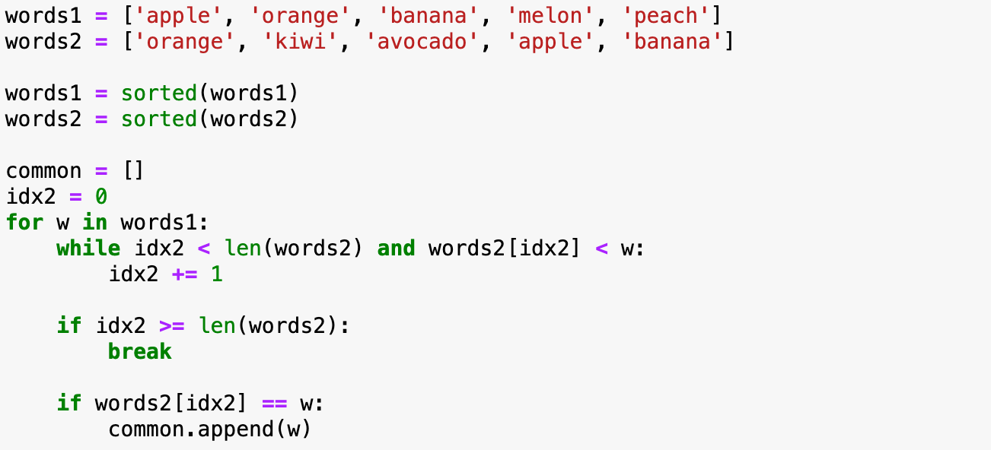

Implementation with sorted lists
What is the big-O complexity of this implementation?

Slide 19
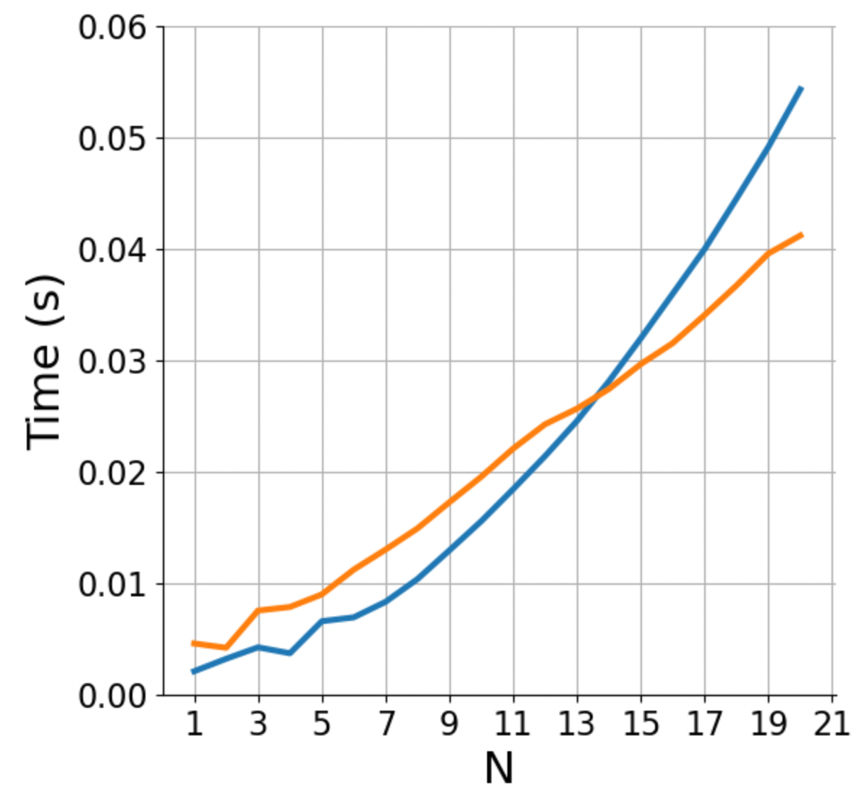

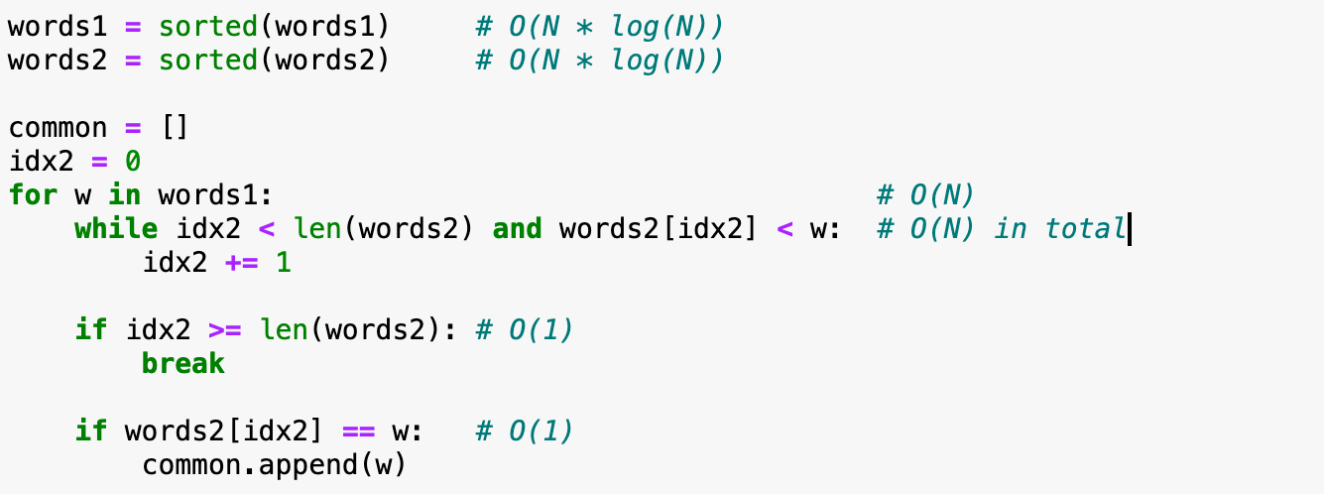
Implementation with sorted lists
What is the big-O complexity of this implementation?
2 * (N * log(N)) + 2 * N ~ O(N log N)

Slide 20
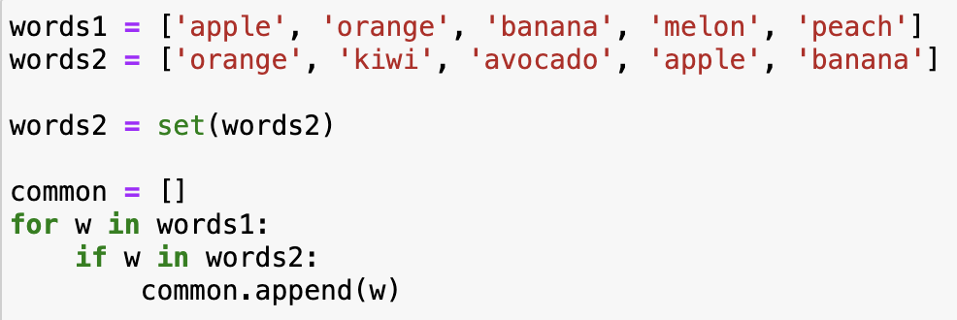
Implementation with sets
What is the big-O complexity of this implementation?

Slide 21
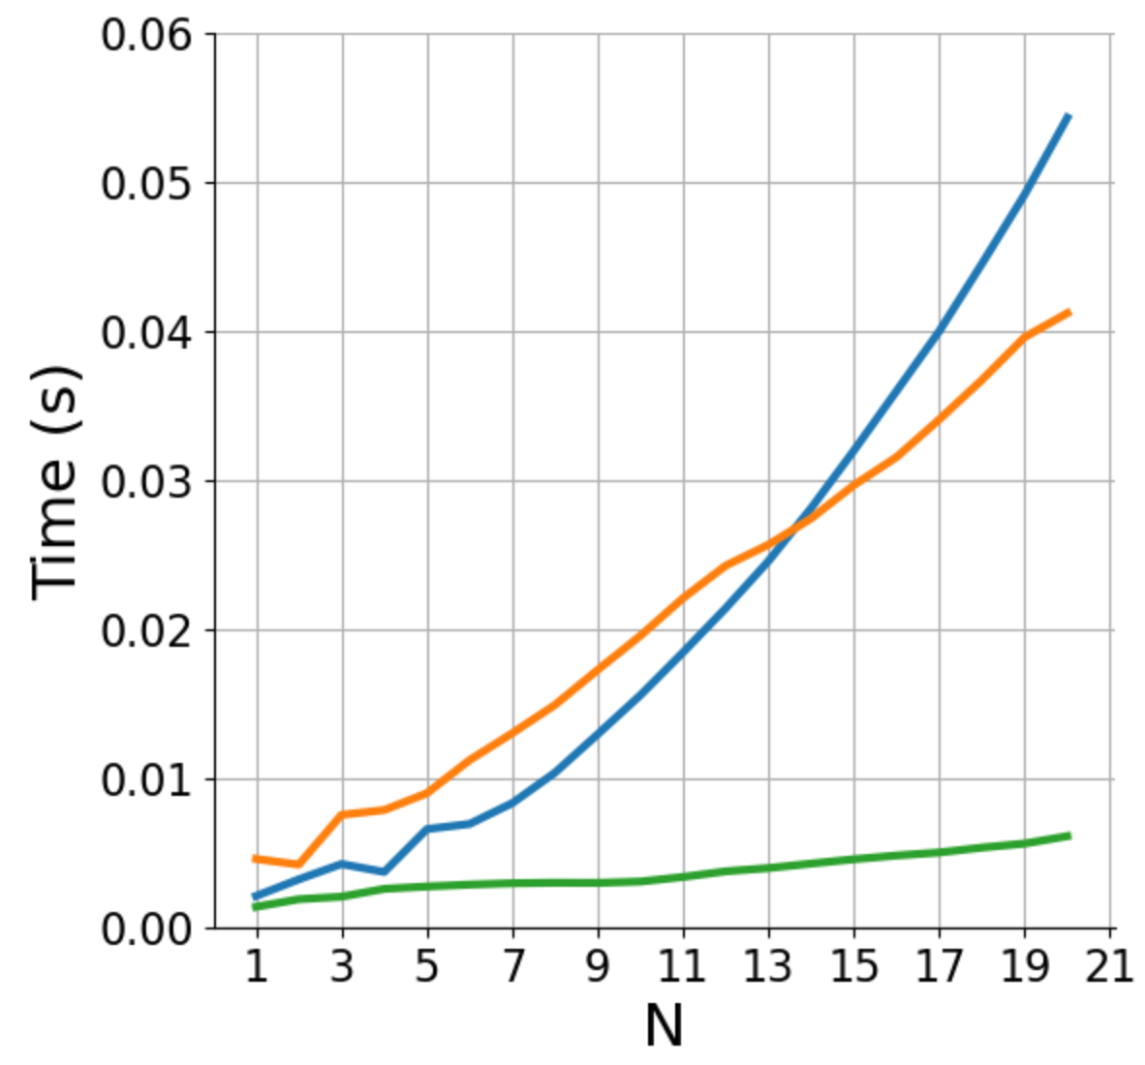
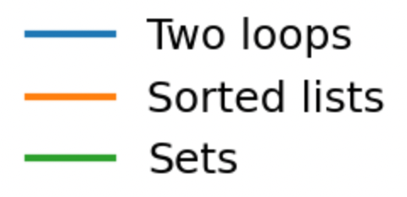
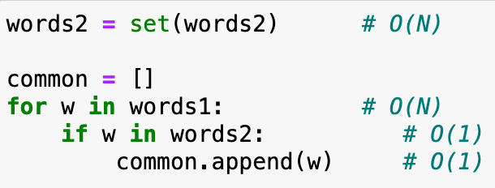
Implementation with sets
What is the big-O complexity of this implementation?
N + N ~ O(N)

Slide 22
Basic reference sheet about Python data structures
Lists: collection of ordered, arbitrary data
Dictionaries (“hashmaps”)
Inserting | O(1)
Finding a value by key (e.g., “if element in my_dict: …”) | O(1)
Getting an element by index | O(1)
Appending | O(1)
Inserting an element at index | O(n)
Sorting | O(n log n)
Finding an element (e.g., “if element in my_list: …”) | O(n)
Sets: it’s dictionaries without values
Inserting | O(1)
Finding a value by key (e.g., “if element in my_set: …”) | O(1)
See also: https://wiki.python.org/moin/TimeComplexity
Notes:
Note that there may be different implementations of these data structures with different complexities, these are for the Python implementation.
E.g., if finding an element in a list is important, one could implement it as two dictionaries, one mapping indices to data, one mapping data to indices. Finding out the complexities of all the operations with this implementation is left as a homework.

Slide 23
Hands-on
Exercise
exercises/match_tarots
Open the notebook match_tarots, and follow the instructions!
Submit a PR for Issue #7 on git.aspp.school/ASPP/2024-heraklion-data

Slide 24
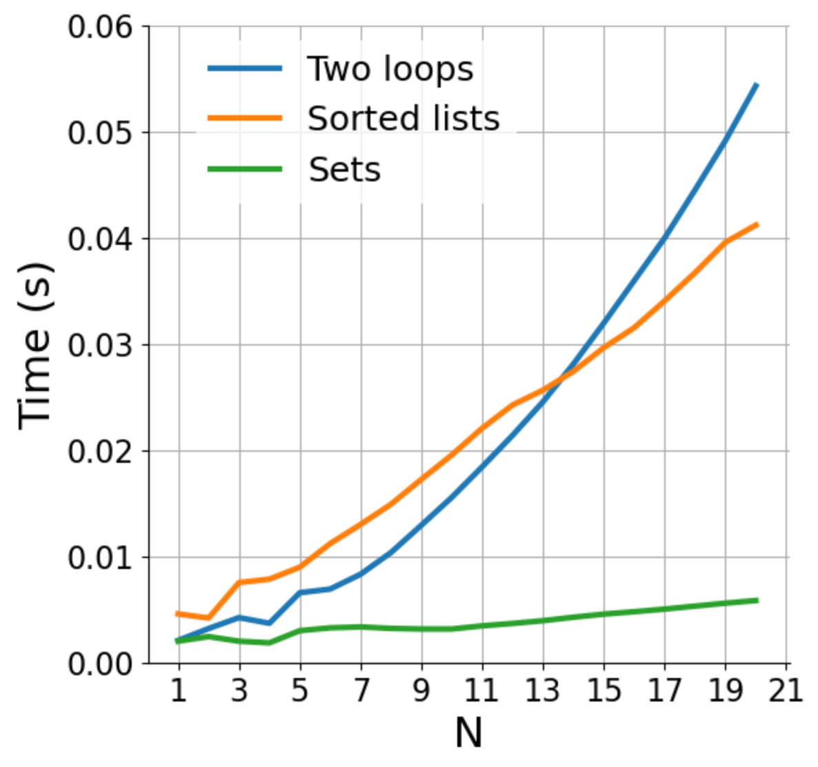
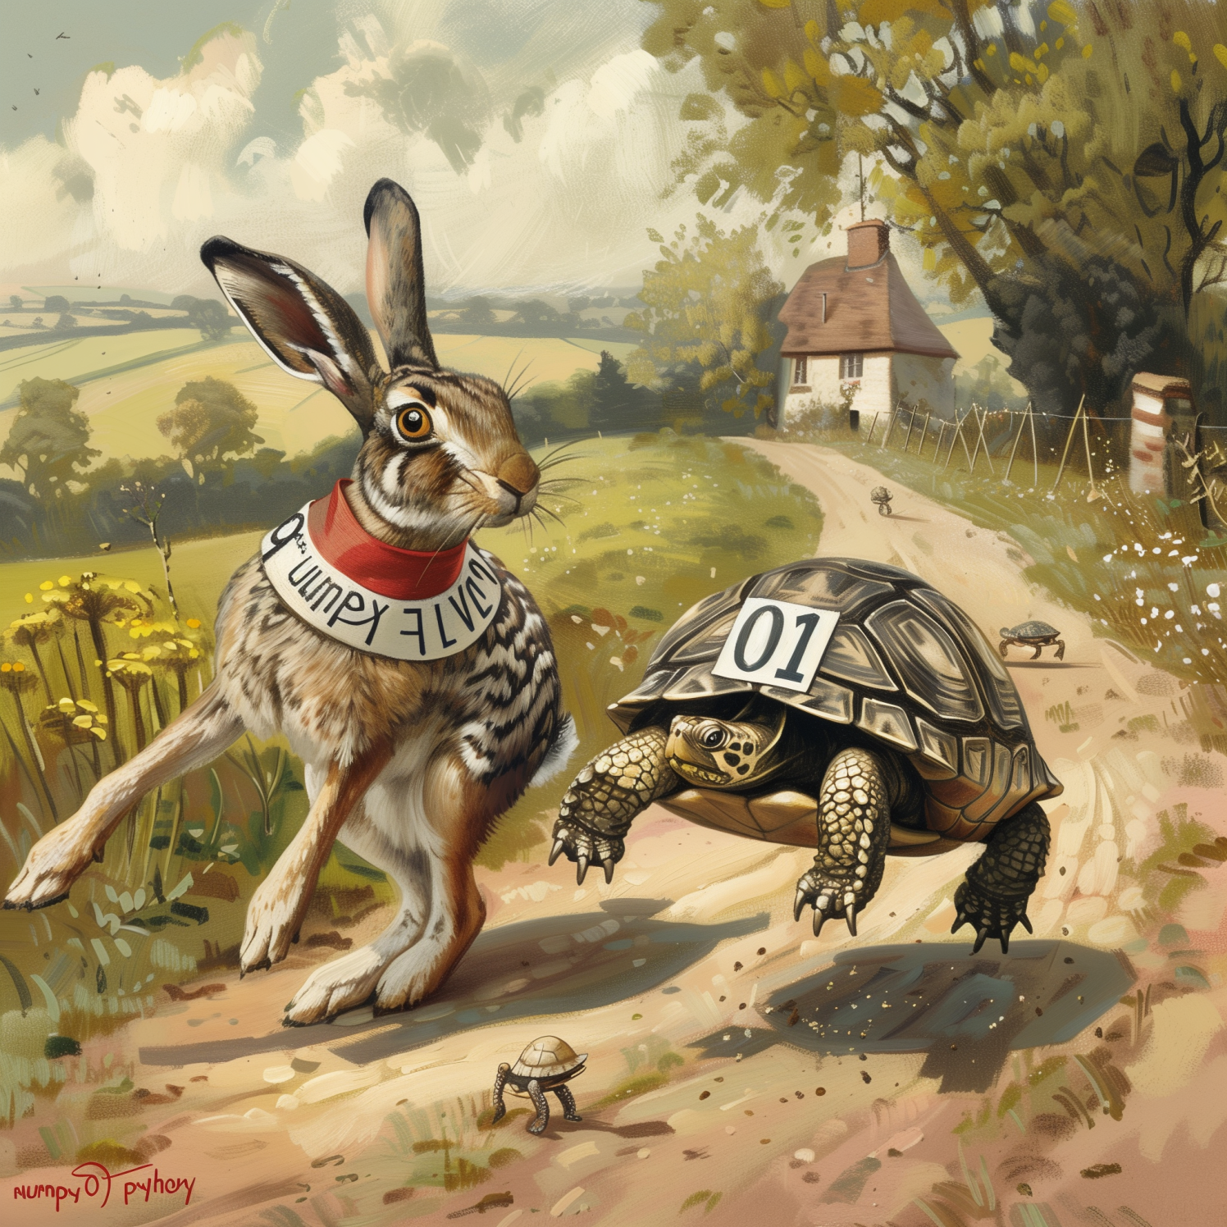
How does rewriting in C change the performance? (rewriting in C, parallelization; same algorithm)
Fast execution
Slow scaling O(n²)
Fast code
O(n²)
Regular code
O(n log n)
Slow execution
Fast scaling O(n log n)
Notes:
Parallelization lowers the curves.
For a fixed code, linear code is no necessarily faster.
Important when n is growing
Parallelization/ optimization → you can make the code faster for any fixed N, but the shape (of growth) can never change

Slide 25
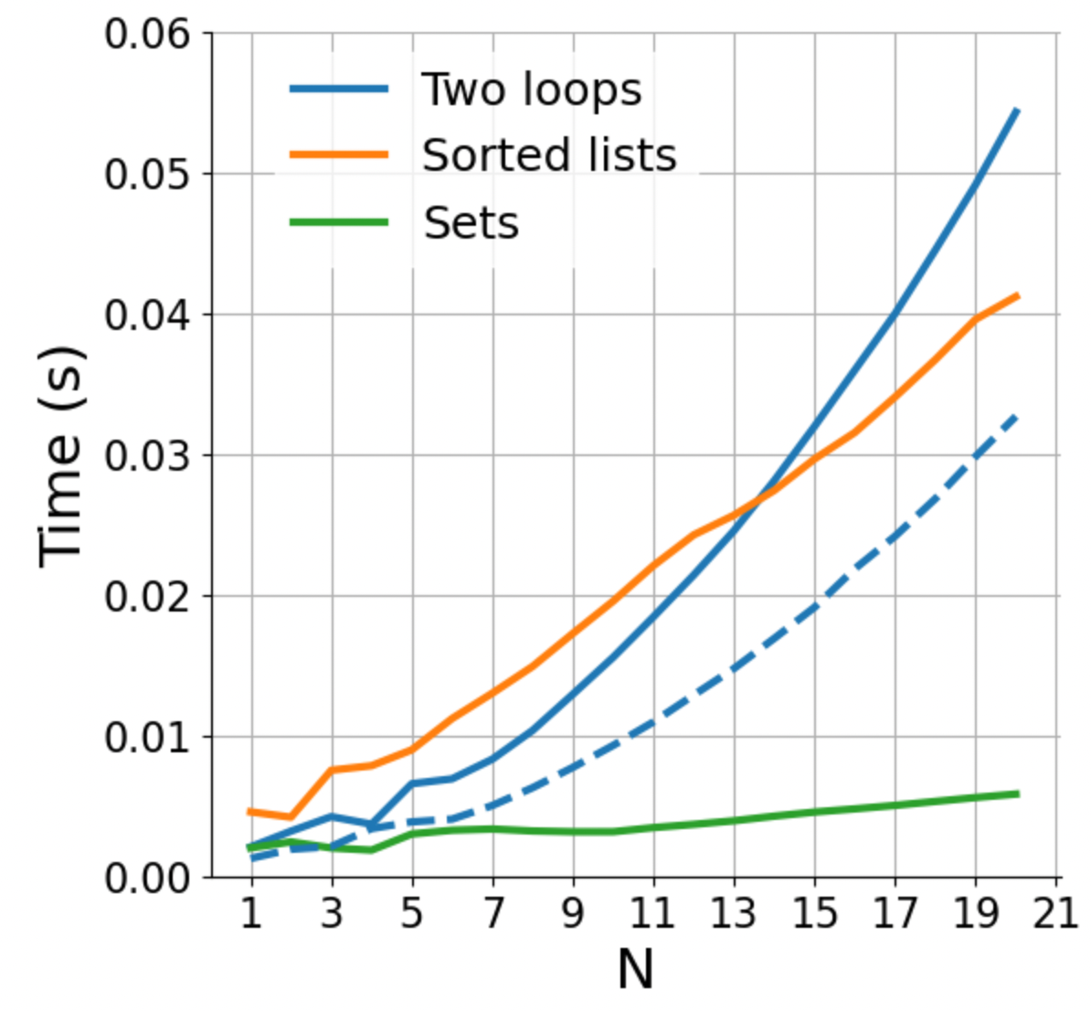
How does rewriting in C change the performance? (rewriting in C, parallelization; same algorithm)
Faster language increases performance for fixed N
Fast code
O(n²)
Regular code
O(n log n)
Notes:
Parallelization lowers the curves.
For a fixed code, linear code is no necessarily faster.
Important when n is growing
Parallelization/ optimization → you can make the code faster for any fixed N, but the shape (of growth) can never change

Slide 26
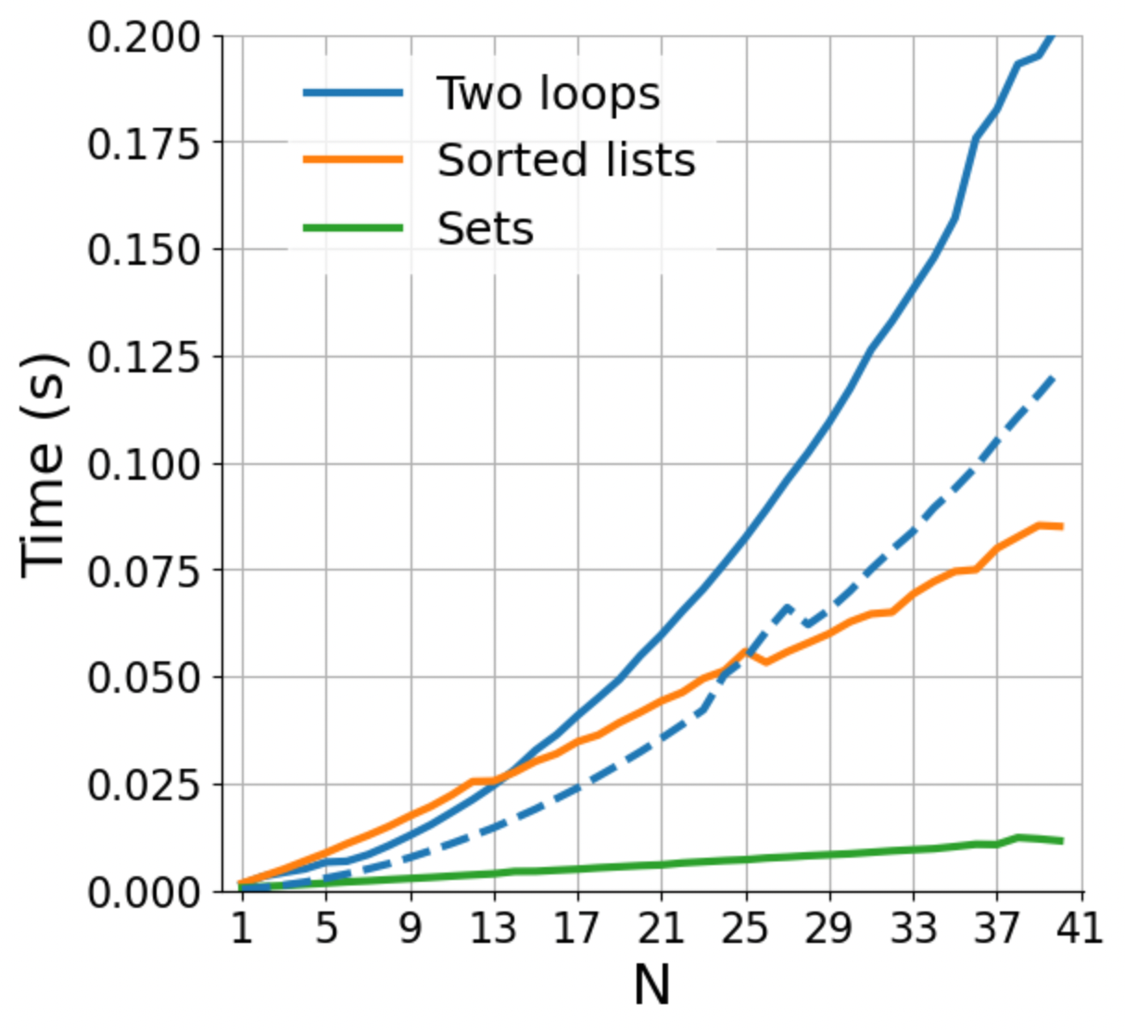
How does rewriting in C change the performance? (rewriting in C, parallelization; same algorithm)
Fast code
O(n²)
Regular code
O(n log n)
Notes:
Parallelization lowers the curves.
For a fixed code, linear code is no necessarily faster.
Important when n is growing
Parallelization/ optimization → you can make the code faster for any fixed N, but the shape (of growth) can never change

Slide 27
How does rewriting in C change the performance? (rewriting in C, parallelization; same algorithm)
Fast code
O(n²)
We need to distinguish between “fast” in absolute terms for a fixed problem size, and “fast” in the sense of how well it scales
Regular code
O(n log n)
Notes:
Parallelization lowers the curves.
For a fixed code, linear code is no necessarily faster.
Important when n is growing
Parallelization/ optimization → you can make the code faster for any fixed N, but the shape (of growth) can never change

Slide 28
COMING UP NEXT: NumPy and the array data structure

Slide 30
Some data structures
list: ordered, heterogeneous storage, stack/queue, fast access by index, slow search
set: unordered
dictionary
arrays: e.g. numpy, HDF5
tables: e.g. pandas, dask, spark, SQL
graph: social network structure
tree: to rapidly search a dataset
heap
stack
queue
priority queue

